Slide 1
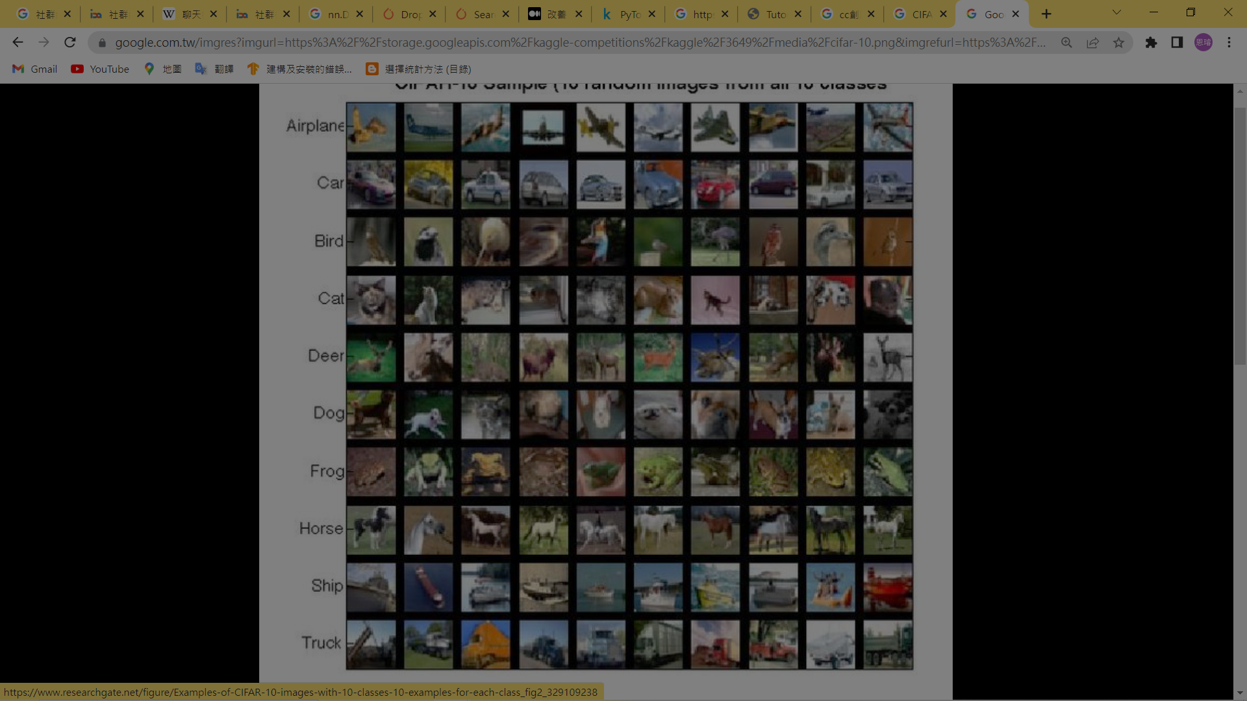
Machine Learning
CIFAR 10
Convoluted Neural Network (CNN)
and CIFAR10

Slide 2
Contents
CIFAR 10
． Data
． Convoluted Neural Network Model 1
． Training Results 1
． Convoluted Neural Network Model 2
． Training Results 2
． Model Optimization

Slide 3
Data
CIFAR 10
． CIFAR10 圖片
． 圖片資料組成
． 資料分組

Slide 4
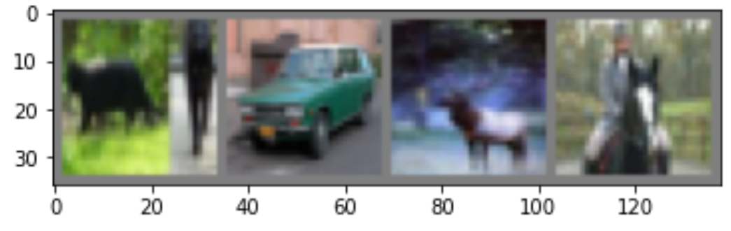
CIFAR10 圖片
來源：torchvision.datasets.CIFAR10
數量：共60000張圖片
種類：10 類群

Slide 5
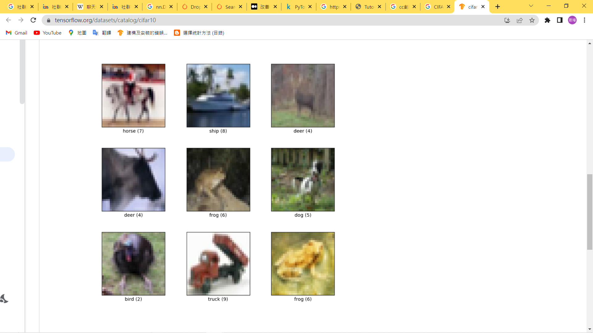

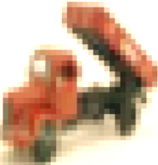
圖片資料組成
每張全彩圖片有一個分類標籤
全彩圖片由紅、藍、綠三張單色圖片組成。
單色圖片有 32*32 的資料點
(32, 32)
(3, 32, 32)

Slide 6
資料分組
Training data
Testing data
Training set：50000張
Testing set：10000張
plane
car
bird
cat
deer
dog
frog
horse
ship
truck

Slide 7
Convoluted Neural Network Model 1
CIFAR 10
． Layers of Model 1
． Convoluted Net 1
． Parameters

Slide 8
Layers of Model 1
Convolution：2 layers
Activation function：ReLU function
Pooling：MaxPool
Linear ：Linear + ReLU, 3 Layers
6 channels
16 channels
3 channels
Linear layers

Slide 9




Convolution Net 1
Linear layers

Slide 10
Parameters
Epochs：100 ( 將Training set 完整訓練100次 )
Batch：4 / per batch ( 4張照片為一組 )
Learning rate：0.001 ( 學習速率 )
Batch 1
Batch 2
Batch 3
Batch 4
Batch 12498
Batch 12499
Batch 12500
* 100 Epochs

Slide 11
Training Results 1
CIFAR 10

Slide 12
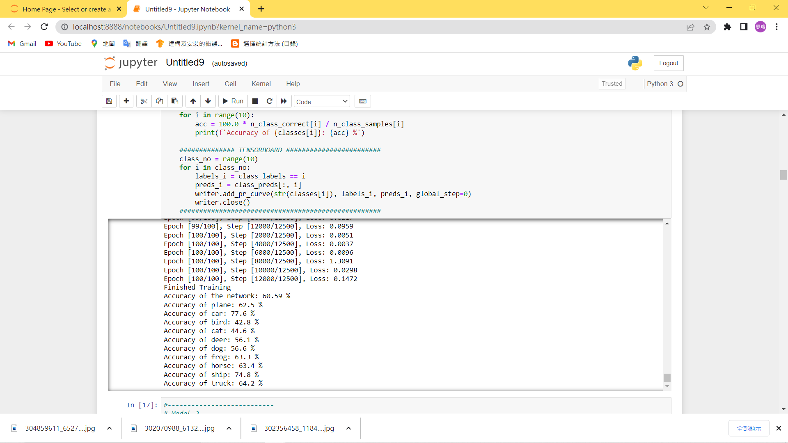
Result of Model 1
Accuracy of the model：
Accuracy of each class：

Slide 13
Convoluted Neural Network Model 2
CIFAR 10
． Layers of Model 2
． Convoluted Net 2
． Parameters

Slide 14
Layers of Model 2
Convolution：3 layers
Activation function：ReLU function
Pooling：MaxPool
Linear ：Linear function, 4 Layers
42 channels
84 channels
168 channels
3 channels
Linear layers

Slide 15


Convolution Net 2
Linear layers

Slide 16
Parameters
Epochs：100 ( 將Training set 完整訓練100次 )
Batch：4 / per batch ( 4張照片為一組 )
Learning rate：0.001 ( 學習速率 )
Batch 1
Batch 2
Batch 3
Batch 4
Batch 12498
Batch 12499
Batch 12500
* 100 Epochs

Slide 17
Training Results 2
CIFAR 10

Slide 18
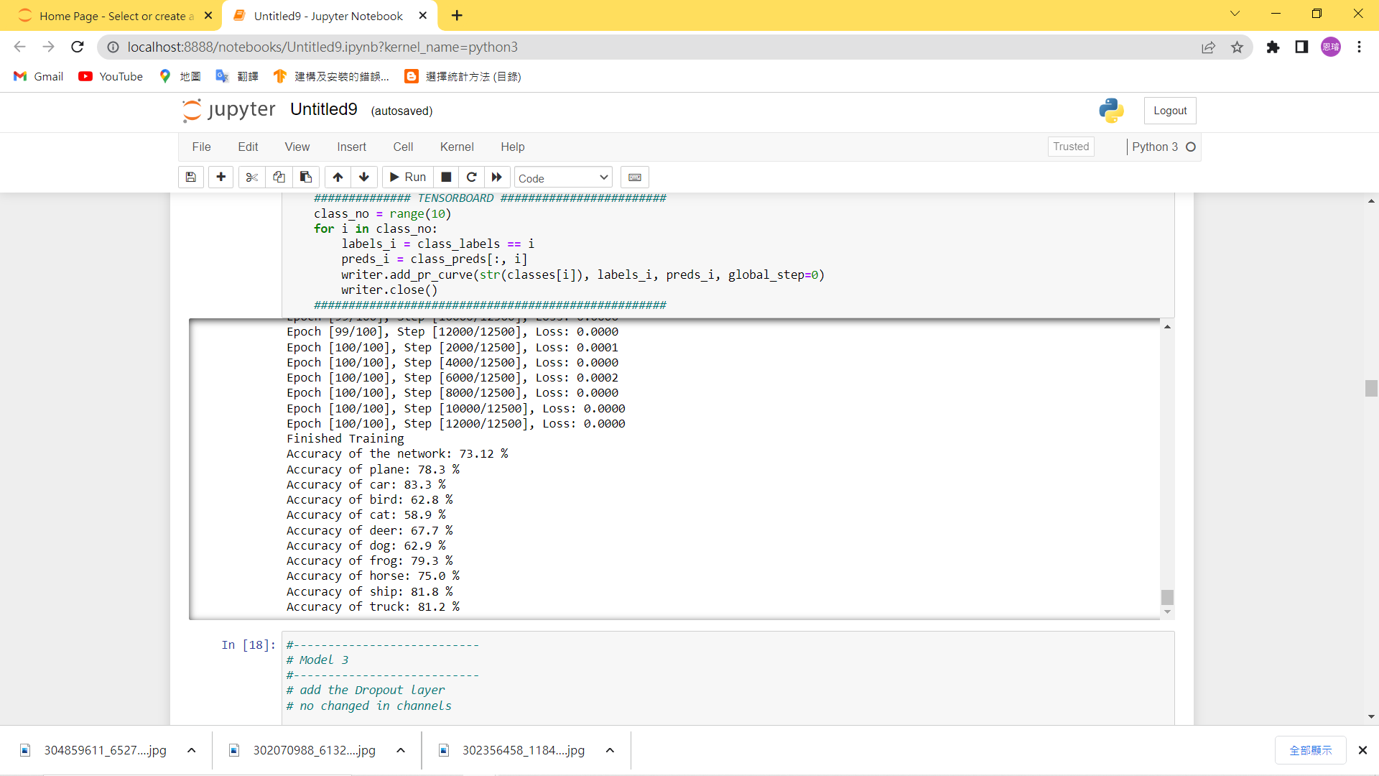
Result of Model 2
Accuracy of the model：
Accuracy of each class：

Slide 19
Model Optimization
CIFAR 10

Slide 20
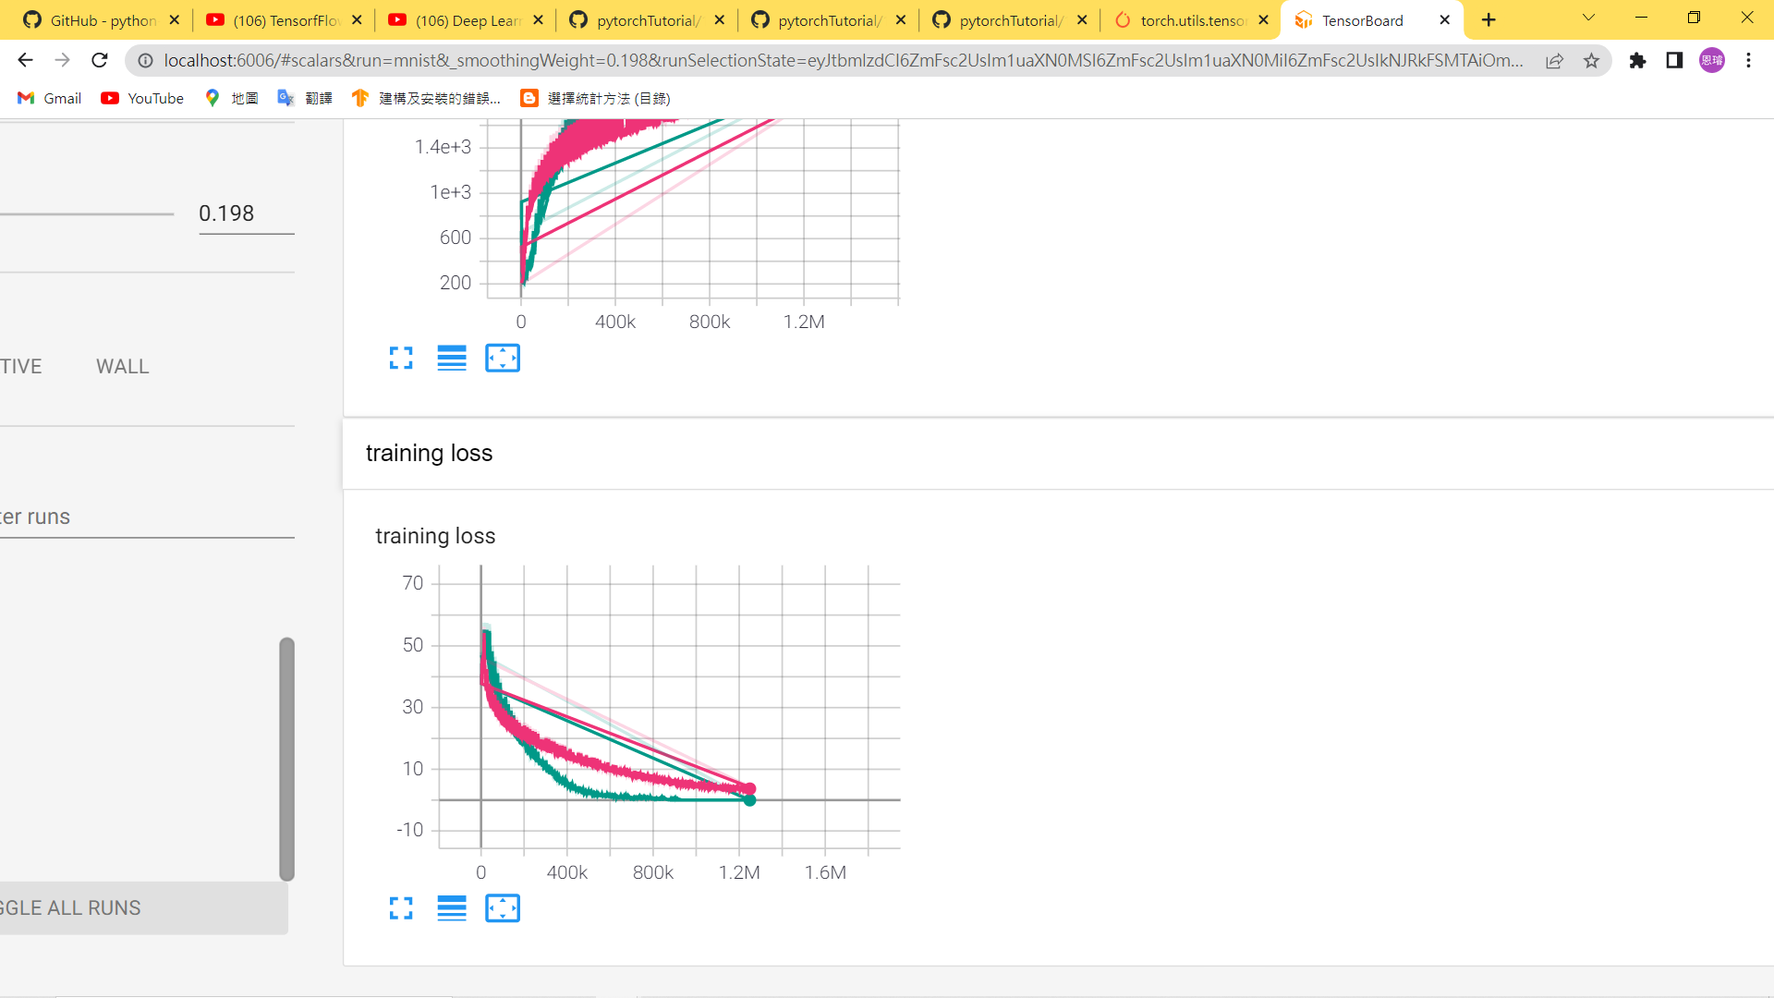
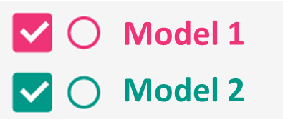
History of Loss

Slide 21
History of Loss

Slide 22
History of Loss

Slide 23
Thanks for your Attention
CIFAR 10

Slide 24
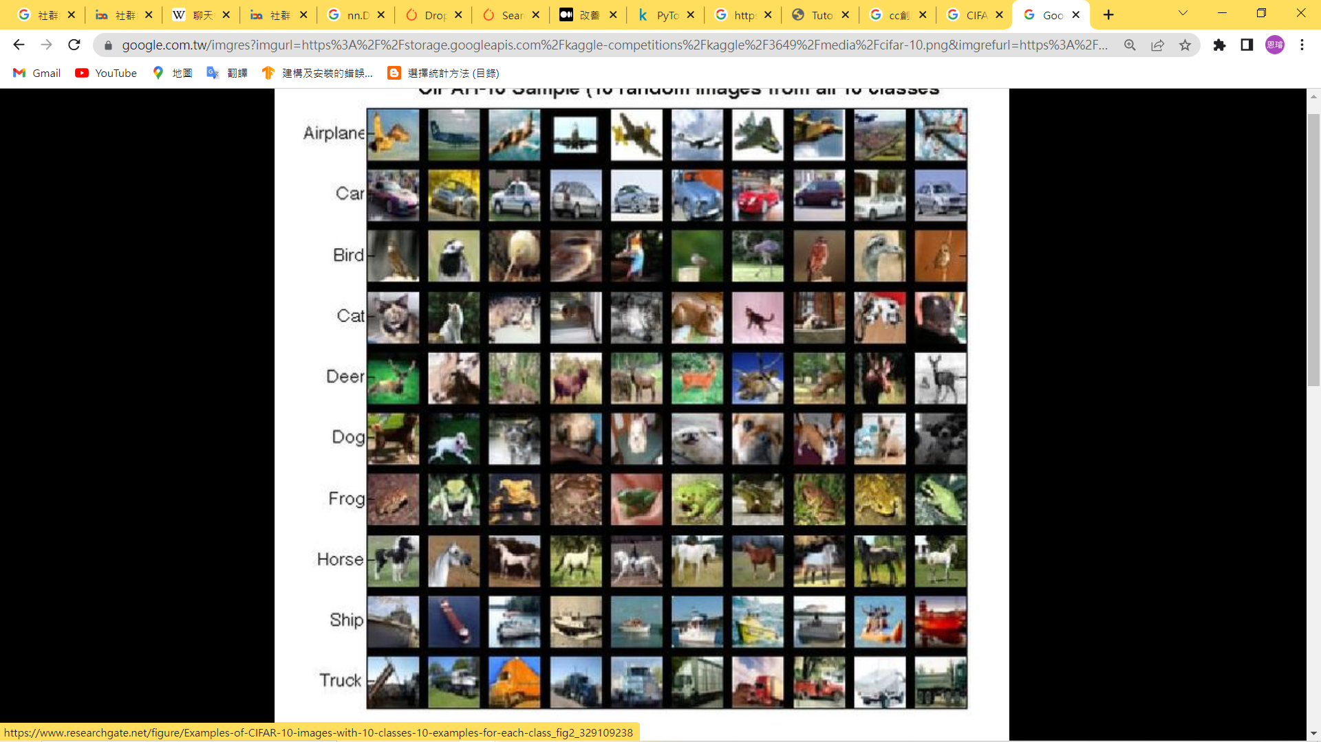
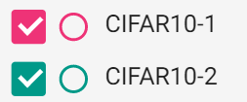
Model 1
Model 2
Input
Convolution 1
Activation
Pooling
Convolution 2
Activation
Pooling
Convolution 3
Activation
Pooling
Linear 1
Linear 2
Linear 3
Linear 4

